Slide 1
Discrimination and Harassment Prevention
Faculty Senate - April 17, 2018
Presenter: Sharon Nolan-Weiss

Slide 2
EDI’s Role
Investigating reports of discrimination and harassment
Providing assistance and advice to employees, supervisors and managers regarding workplace situations and actions
Together with Accessibility Resources, assisting with accommodation situations
Training faculty, staff and students in discrimination and harassment prevention, cultural competence, respect and civility, and recruiting for diversity
Providing information about complying with child protection requirements

Slide 3
Training Options
Intersections Online Harassment Prevention Training
Can be mandated and tracked through UBEdge
Athletics has mandated this division-wide.
In-Person Training
Mandated by individual schools and departments
Pharmacy, Engineering, Surgery, Neurosurgery, Public Health have mandated or will mandate in-person training.
Other Outreach
Annual email notification to all employees of Discrimination and Harassment Policy
Title IX: Sexual Misconduct Resource Card

Slide 4
Current issues

Slide 5


Slide 6
2017 to Present: Major Developments
University of Rochester case
USA gymnastics – Michigan State
2017: “The year your love for your favorite celebrities died”
Priorities:
Examining UB’s policy framework and practices to prevent and respond effectively to sexual misconduct
Promoting a culture of professionalism and integrity that encourages reporting

Slide 7
UB Policies
Discrimination and Harassment
Prohibits unwelcome sexual advances, requests for sexual favors, or other verbal or physical conduct that could create a hostile work or educational environment
Nepotism
Requires disclosure of factors that could represent a conflict of interest, including romantic relationships
Faculty Code of Conduct
Prohibits romantic/sexual relationships between faculty and students whom they are grading, supervising, or exercising other academic authority

Slide 8
Sexual Violence, Domestic Violence and Stalking
These fall within the definition of sexual harassment if they impact the work or educational environment.
UB must respond in situations where there is a hostile environment.
This applies regardless of whether a UB student or employee is creating the hostile environment, or whether it is created by a patient, hospital employee or others.

Slide 9
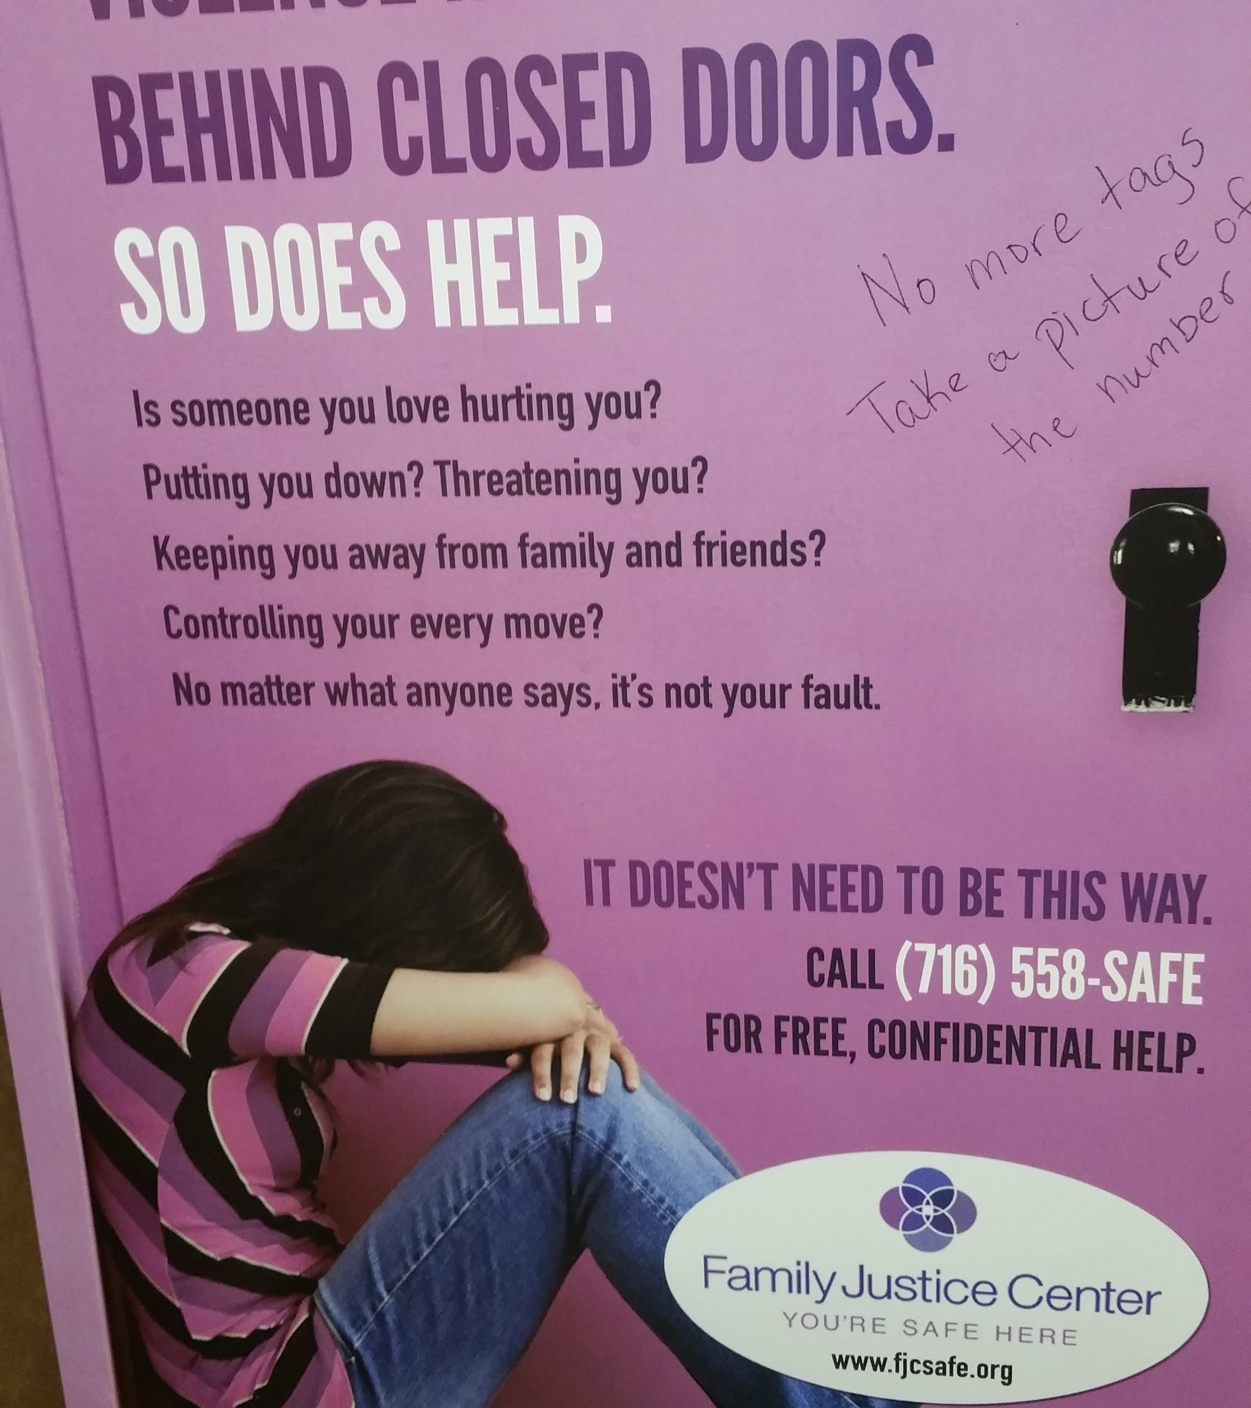
RELATIONSHIP VIOLENCE
UB has resources for students and employees who experience relationship violence. These include:
On-Campus Crisis Services Advocate
UPD assistance
Academic and workplace accommodations

Slide 10
Accommodations and accessibility

Slide 11
Accommodation Trends and Challenges
“Religion-neutral” calendar and exams
Students with disabilities that impact attendance
Preferred name developments
Pregnancy and parenting accommodations
Accommodations for students who have experienced sexual misconduct

Slide 12
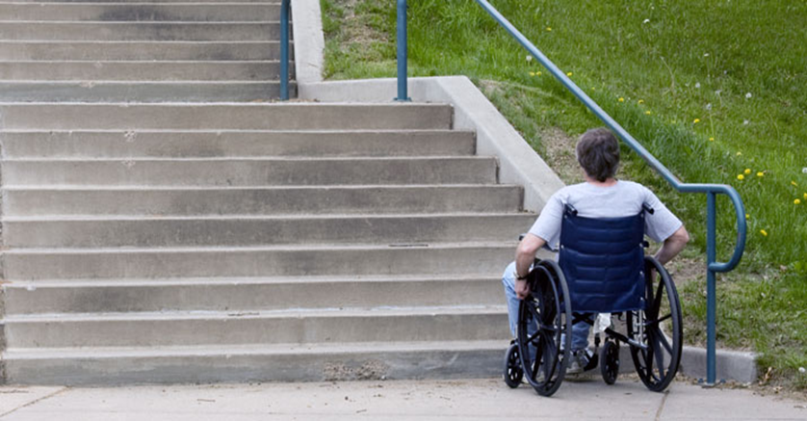
Digital Accessibility
We often think of accessibility in a physical sense.
Inaccessible electronic communications are an equal challenge for individuals with disabilities.

Slide 13
What is Digital Accessibility?
Digital accessibility (also known as electronic accessibility, Web accessibility) is electronic hardware, software, and communications that can be accessed by individuals with a range of disabilities, including those using assistive technology.
Assistive technology is hardware or software that allows access to technology for individuals with disabilities, such as captioning, screen-reading software, and special input devices.

Slide 14
Common Accessibility Issues
Websites, documents (PDFs), and other information cannot be accessed with a screen reader.
The document or webpage is set up so that a screen reader cannot make logical sense of it (ex. links are not identified clearly)
A mouse is required to navigate a webpage (ex. important content cannot be accessed by using keyboard tabs, or tab order is illogical)
Videos are not captioned.
Contrast is poor, making text hard to read.
Color is used to convey meaning.

Slide 15
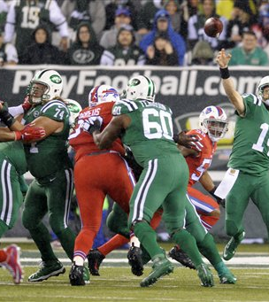
Bills vs. Jets
2015 game with red/green uniforms

Slide 16
Digital Accessibility Challenges in Instruction
Many instructors incorporate videos, message boards, publisher websites, and other electronic media as part of instruction.
These are not always accessible.
Tools such as clickers may pose challenges for individuals with impairments.
Vendors often sell inaccessible products
It is difficult/impossible to know all of the electronic tools that faculty are using.

Slide 17
Questions?

Slide 18
For More Information
Office of Equity, Diversity and Inclusion
406 Capen Hall
645-2266
aa-diversity@buffalo.edu

